Slide 1
Chapter 9
Securing Your Network

Slide 2
Object
• Explain why security is important
• Discuss practical security preparations
• Explain how malicious attacks occur
• Use techniques to protect a network
• Design security into home and office networks
http://fpt.edu.vn

Slide 3

Why security is important
Protecting information and resources so that a business or an organization can keep doing business without problems or interruptions
Ensuring privacy of personal information, such as medical records
Protecting against identity and credit card theft
Facilitating workflow so that the work and play of family members, students, and members in an organization is not delayed or brought to a halt
Discouraging computer attackers from further malicious attacks
http://fpt.edu.vn

Slide 4
Using Operating System Security Features
Require password protected accounts for logon
Use latest authentication and encryption techniques
Use digital certificates for network communication
Configure permissions for file and folder security
Employ shared resource security, such as share permissions
http://fpt.edu.vn

Slide 5
Using Operating System Security Features (cont)
Set up security policies
  Require “strong” passwords for accounts
  Lock out accounts after excessive logon attempts
Configure best wireless networking security available
Set up virtual private networks (VPNs) for secure remote communications
Use disaster recovery techniques, such as regular backups
http://fpt.edu.vn

Slide 6
Using Network Security Features
Some combination of network devices and software
Four network-hardening techniques
  Design networks around switches and routers
    Devices control access to specific portions of a network
  Employ network and operating system firewalls
  Use star-based network topology, a secure design
  Regularly monitor network activity
http://fpt.edu.vn

Slide 7




Learning More About Security
Partial list of organizations providing security support
  American Society for Industrial Security (ASIS)
  Computer Emergency Response Team Coordination Center (CERT/CC)
  Forum of Incident Response and Security Teams (FIRST)
  InfraGard
  Information Security Forum (ISF)
  Information Systems Security Association (ISSA)
  National Security Institute (NSI)
  SysAdmin, Audit, Network, Security (SANS) Institute
http://fpt.edu.vn

Slide 8

Anatomy of Malicious Attacks
Attacks may target operating system, network or both
A partial listing of typical attacks
  Stand-alone workstation or server attacks
  Attacks enabled by access to passwords
  Viruses, worms, Trojan horses, and spyware
  Buffer attacks, denial of service
  Source routing attacks, port scanning
  Spoofing, e-mail attacks, unsolicited commercial e-mail
  Wireless attacks
  Inside attacks
  Social engineering
http://fpt.edu.vn

Slide 9
Stand-Alone Workstation or Server Attacks
Simple attack centers on unattended computer
  User may not have logged off before leaving desk
  Screen saver with password may not be configured
Servers may also be targets
  System administrator steps away without logging off
  Unauthorized individual gains access to computer room
Configure screen saver with password
    A simple but effective means of gaining protection
http://fpt.edu.vn

Slide 10
Attacks Enabled by Access to Passwords
Guard access with password protected user account
Counter-productive practices
  Sharing passwords with others
  Displaying password in work area
Sophisticated techniques used to acquire password
  Logon to key administrator accounts locally or remotely
  Use Domain Name system (DNS) on a network
    Find user account name
    Attempt access with passwords generated by software
http://fpt.edu.vn

Slide 11
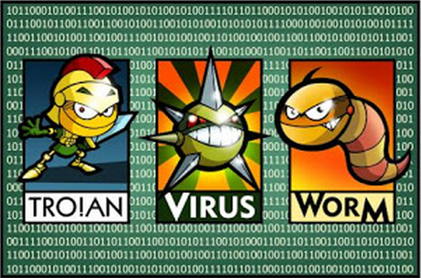
Viruses, Worms, and Trojan Horses
Virus: unwanted program relayed by disk or file
  Can replicate throughout system
  Some can cause permanent damage
Virus hoax: e-mail falsely warning of a virus
  Intended to cause message forwarding
  Generates needless worry and extra traffic
Worm: copies itself or sends itself to other computers
Difference between worm and virus
  Worms create new files, viruses infect files and disks
Trojan horse: a malicious program in disguise
  Example: Trojan.Idly returns target account/password
http://fpt.edu.vn

Slide 12
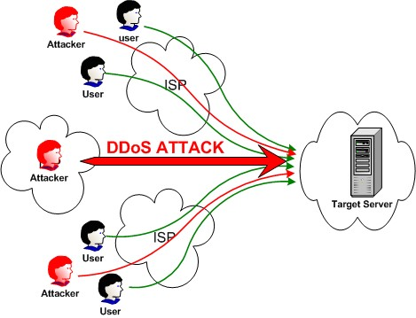
Denial of Service
Also known as DoS attack
Blocks access to network host, Web site or service
Using the local network to launch DoS attacks
  Shutdown server via Administrator account
  Overrun disk capacity on system without disk quotas
Remote technique: flood network with erroneous data
  May be frames or packets with unidentifiable errors
  Example: Jolt2 sends packet fragments that cannot be reconstructed
Distributed denial of service (DDoS) attack
  Attack computer causes others to send attack packets
http://fpt.edu.vn

Slide 13
Source Routing Attack
Source routing: packet sender specifies precise path
  Used for network troubleshooting and on token rings
  Example: traceroute utility maps route through network
Source routing attack
  Source address and routing data modified
  Packet appears to come from a different source
Benefits to attacker
  Trust (misplaced) on the network
  Access to privately configured network
    May use Network Address Translation (NAT)
    NAT translates IP private address to public form
http://fpt.edu.vn

Slide 14
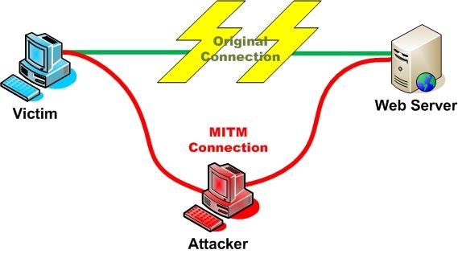
Spoofing
Address of source packet altered to disguise attacker
Several ways to launch attack
  Attacker initiates access to a computer
  Attacker appears as legitimate transmission
Spoofing encompasses other types of attacks
  Source routing attack
  DoS attack flooding host with packets from bogus sources
http://fpt.edu.vn

Slide 15

E-mail Attack
A variety of forms to trick recipient
  Attacker may be disguised as friendly or trusted source
  E-mail may have tempting subject; e.g., contest winner
How an e-mail can cause damage
  File attachment may have virus, worm or Trojan horse
  May contain link to rogue Web site
  Contains request for information update
    User passes demographic and credit card data
    Attacker uses data to carry out identity theft
http://fpt.edu.vn

Slide 16
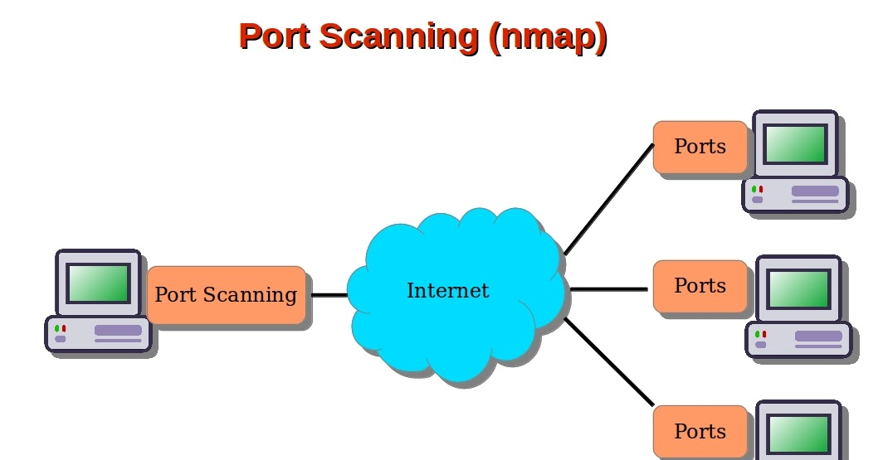
Port Scanning
Port: similar to virtual circuit between computers
TCP/IP uses TCP or UDP ports (sockets) with IP
  Access ways linked to service, process, or function
  65,535 ports in TCP and UDP
Attackers may use ports to gain remote access
  Step 1: determine live IP address on network
  Step 2: scan system for open ports or ports not in use
  Step 3: attack service, such as DNS on port 53
Ways of blocking access to an open port
  Configure service to start with your knowledge
  Stop operating system services or processes not in use
    Example: use kill command in Fedora to stop gaim
http://fpt.edu.vn

Slide 17

Wireless Attacks
Difficult to identify
Sometimes called war-drives
  Attacker seeks signal using laptop in car
  Attacker may also seek signal on foot
Key elements used in attack
  Wireless network interface card
  Omnidirectional antenna
  War-driving software to capture and interpret signals
Multiple channels scanned
  Device like scanner used to listen to police channels
http://fpt.edu.vn

Slide 18

Spyware
Software that reports user's activities to attacker
Means of installing spyware
  Through virus or Trojan horse
  In conjunction with legitimate freeware programs
May operate externally, such as on the Web
  Spyware captures cookies or data written to cookies
    Cookie: information stored by Web server on client
  Spynet and PeepNet are "cookie snarfing" tools
Discouraging cookie snarfing spyware
  Disable cookie creation through Internet browser
http://fpt.edu.vn

Slide 19
Inside Attacks
Sources
  Disgruntled and temporary employees
  Consultants
  Vendor representatives
  Industrial spies
Wide range of information sought
  Financial, personnel, organizational, research
Sensitive data typically located in databases
http://fpt.edu.vn

Slide 20
Social Engineering Attacks
Relies on human interaction to gain system access
Many types of interactions fall into category
  Provide enticing subject head on e-mail
  Send e-mail with attractive attachment
  Solicit credit card information disguised as vendor
  Request user account information over phone
Prevention: train users so they are aware of tactics
http://fpt.edu.vn

Slide 21
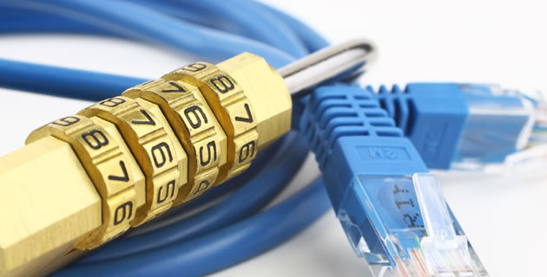
How to Protect Your Network
There are many ways to protect your network
Several methods to be discussed
  Updating operating systems
  Using IP Security (IPSec)
  Establishing border and firewall security
http://fpt.edu.vn

Slide 22
Installing Updates
Updates and patches help prevent attacks
Cautionary note: Slammer worm against SQL server
  New patches not installed by many administrators
Major operating systems provide updates and patches
  Windows XP Professional
  Windows Server
  Fedora
  Red Hat Enterprise Linux
http://fpt.edu.vn

Slide 23
Using IP Security
IPSec secures IP at the Network layer
Review the Network layer
  Reads IP packet address and forwards on best route
  Permits packets to be routed between networks
  Checks and corrects packet sequence errors
Vulnerabilities of the Network layer
  Packet addressing and packet sequencing
  Example: interception and substitution of packets
Flow of IPSec communication
  Two computers exchange certificates for authentication
  Sender encrypts data as it formats IP packet
http://fpt.edu.vn

Slide 24
Using IP Security (continued)
Encryption takes place at the Presentation layer
  Service: Encapsulating Security Payload (ESP)
Three roles of Windows Server using IPSec
  Client (Respond Only): respond to client using IPSec
  Server (Request Security): use IPSec by default
    Switch to clear mode if IPSec not employed by client
  Secure Server (Require Security): require IPSec
IP Security Policies Management Snap-in
  Applies security standards either locally or to domain
Configuring IPSec on UNIX/Linux systems
  Use command utilities or graphical tools (if available)
http://fpt.edu.vn

Slide 25
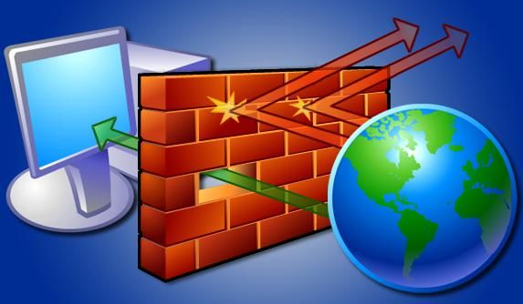
Establishing Border and Firewall Security
Border hazards: viruses, worms, other attackers
Border gateway: firewall controlling traffic flow
  Example: block IP communications from specific source
Border points protected with border security
  Connection points between LANs and WANs
  Dial-up and cable modem access
  Virtual private network (VPN) access
  Short-range wireless access
  Long-range wireless access
Scenario involving company with four subsidiaries
  Place firewalls at borders of public and private networks
http://fpt.edu.vn

Slide 26
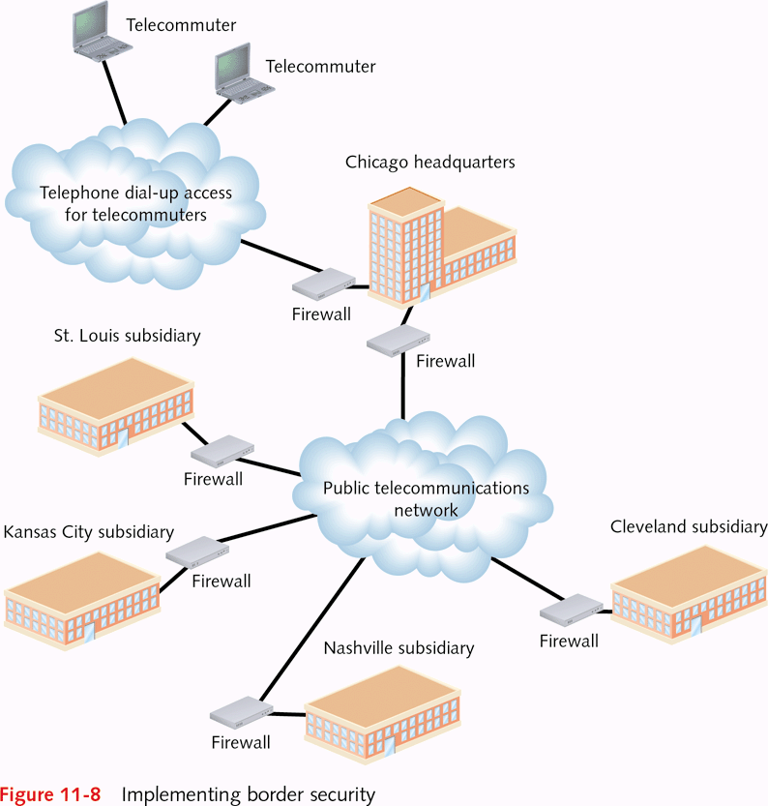
http://fpt.edu.vn

Slide 27
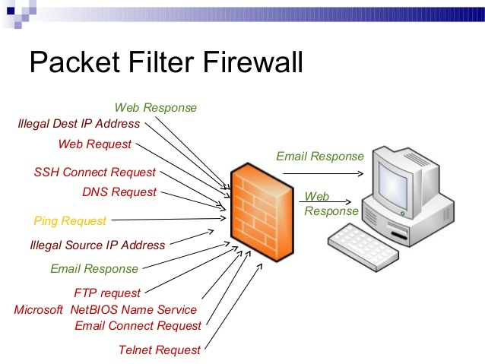
Using Packet Filtering
Multi-purpose
  Establish filter between connected networks
  Allow or block packets from specific protocols
Important components of packet filters
  IP address information in packet
    Specify valid IP addresses or address characteristics
  TCP (or UDP) port information
    Control access by TCP and UDP port number
Two ways to implement packet filtering
  Stateless: packet scanned for contents only
  Stateful: includes communication context
http://fpt.edu.vn

Slide 28
Using Network Address Translation (NAT)
NAT presents single network address to outsiders
  Example: NAT address 129.81.1.1 hides internal range
Recommended ranges by network type
  Class A networks: 10.0.0.0 to 10.255.255.255
  Class B networks: 172.16.0.0 to 172.31.255.255
  Class C networks: 192.168.0.0 to 192.168.255.255
Effectiveness of NAT
  Hides specific computer addresses from attackers
  Lets network use addresses not formally registered
Enhance NAT by using proxy server
  Hampers efforts to spoof legitimate incoming packets
http://fpt.edu.vn

Slide 29
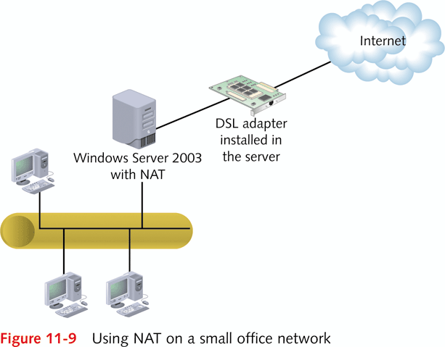
http://fpt.edu.vn

Slide 30
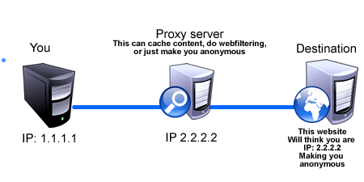
Deploying Proxies
Proxy: computer between local and public networks
Fulfills combination of tasks
  Filter communications
  Act as an application-level gateway
    Different capabilities allow wide range of filtering
    Example: direct HTTP communications to specific server
  Create secure communication tunnels
    Implemented with circuit-level gateway
  Enhance application request performance with caching
    Cache: fast memory for frequently accessed data
    Example: store frequently requested report in cache
http://fpt.edu.vn

Slide 31
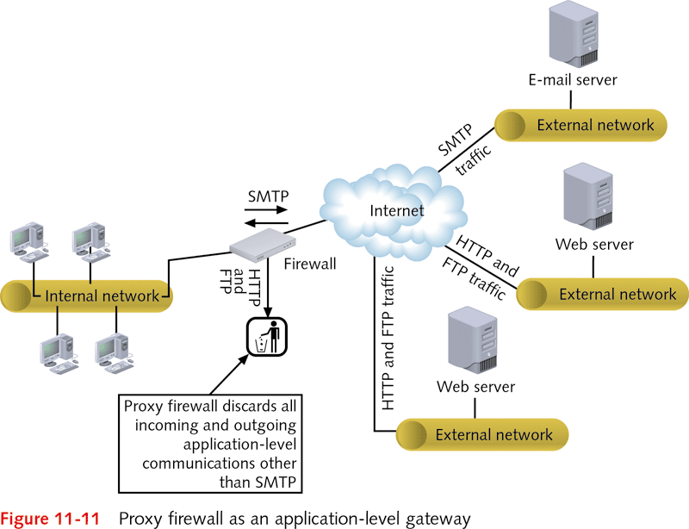
http://fpt.edu.vn

Slide 32
Using Routers for Border Security
Built-in intelligence configured for a number of tasks
  Direct packets to specific networks
  Study network traffic
  Quickly adapt to changes detected in the network
  Protect networks by selecting packets to be blocked
Firewall functions: packet and protocol filtering
Cisco routers deploy access control lists (ACLs)
  ACL: list of permit or deny conditions (as statement)
  Example of deny statement
    Packet with IP address 122.88.15 blocked from leaving network through specific port
http://fpt.edu.vn

Slide 33
Creating a Demilitarized Zone
DMZ: zone between networks with different security
  Example: zone between VPN and Internet
Publicly accessed Web servers often placed in DMZ
  Do not need same level of security as internal servers
  Reduces traffic into sensitive regions of private network
Example of Web server placed in DMZ
  State government server used to access tax forms
http://fpt.edu.vn

Slide 34
Configuring Operating System Firewalls
Critical when computer directly connected to Internet
Also important when computer is in DMZ
Windows firewall availability
  Windows XP Service Pack 2 and higher
  Windows Server 2003 Service Pack 1 and higher
Security Level Configuration tool
  Enables/disables Fedora and Red Hat Linux firewalls
  May be customized by designating trusted devices
    Example: NIC trusted as it connects to secure network
http://fpt.edu.vn

Slide 35
Designing Security For Home And Office Networks
Many steps to secure networks in different circumstances
A few pointers summarizing steps to follow
http://fpt.edu.vn

Slide 36
Designing a Secure Home Network
Personal and work information to be protected
Basic steps to take in designing security
  Set up accounts with passwords on home computers
  Ensure Guest account disabled or has password
  Configure permissions for file and folder security
  Protect shared folders with share permissions
  Utilize virus- and spam-checking software
  Configure security on wireless systems (WEP, WPA)
  Turn off services not used, such as Telnet
  Use NAT if you have a home server
http://fpt.edu.vn

Slide 37
IDS/IPS
Intrusion
  A set of actions aimed at compromising the security goals (confidentiality, integrity, availability of a computing/networking resource)
Intrusion detection
  The process of identifying and responding to intrusion activities
Intrusion prevention
  The process of both detecting intrusion activities and managing responsive actions throughout the network.
Intrusion detection system (IDS)
  A system that performs automatically the process of intrusion detection.
Intrusion prevention system (IPS)
  A system that has an ambition to both detect intrusions and manage responsive actions.
  Technically, an IPS contains an IDS and combines it with preventive measures (firewall, antivirus, vulnerability assessment) that are often implemented in hardware.
http://fpt.edu.vn

Slide 38
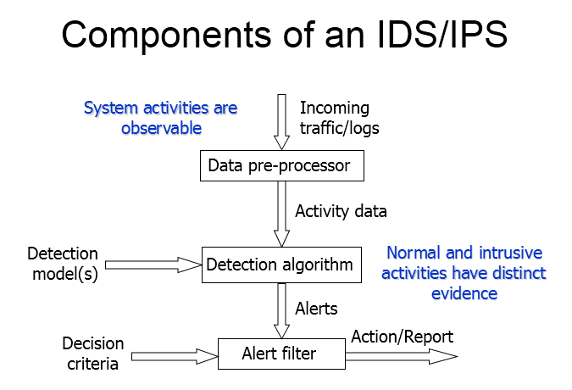
http://fpt.edu.vn

Slide 39
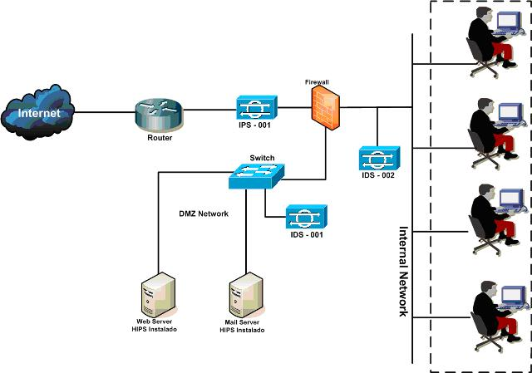
IDS/IPS classification
By scope of protection (or by location)
  Host-based IDS
  Network-based IDS
  Application-based IDS
  Target-based IDS
By detection model
  Misuse detection
  Anomaly detection
http://fpt.edu.vn

Slide 40
IDS/IPS classification
Host-based
Collect data from sources internal to a computer, usually at the operating system level (various logs etc.)
Monitor user activities.
Monitor execution of system programs.
Network-based
Collect network packets. This is usually done by using network devices that are set to the promiscuous mode.
Have sensors deployed at strategic locations
Inspect network traffic
Monitor user activities on the network.
Application-based
- Collect data from running applications.
- The data sources include application event logs and other data stores internal to the application.
Target-based (integrity verification)
Generate their own data (by adding code to the executable).
Use checksums or cryptographic hash functions to detect alterations to system objects and then compare these alterations to a policy.
Trace calls to other programs from within the monitored application.
http://fpt.edu.vn

Slide 41
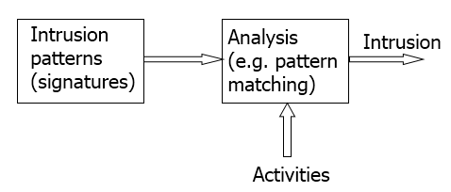
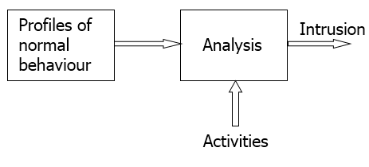
IDS/IPS classification
Misuse detection
Asks the following question about system events: Is this particular activity bad?
Misuse detection involves gathering information about indicators of intrusion in a database and then determining whether such indicators can be found in incoming data.
Anomaly detection
Anomaly detection involves a process of establishing profiles of normal user/network behaviour, comparing actual behaviour to those profiles, and alerting if deviations from the normal behaviour are detected.
The basis of anomaly detection is the assertion that abnormal behaviour patterns indicate intrusion.
http://fpt.edu.vn

Slide 42

Q & A
http://fpt.edu.vn

